Slide 1
A new global atmospheric data assimilation method to estimate high-resolution CO₂ fluxes & uncertainties
David Baker
CIRA/Colorado State
14 Nov 2014
NASA CMS Meeting
Bethesda, MD
in collaboration with
Steven Pawson
NASA/GSFC/GMAO

Slide 3
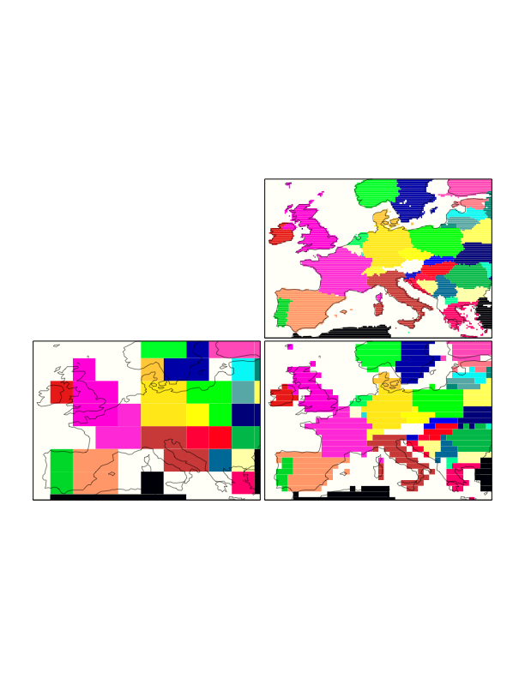
¼°x ¼°
What spatial resolution is
required for useful MRV work?
Good resolution target
(needed for smaller countries)
Good starting point (probably an acceptable resolution for much
of world / larger countries)
Current global inversions
4°x 4°
1°x 1°

Slide 4
Mesoscale CO₂ fluxes & uncertainties from global inversions
Estimate fluxes at the ~25 km resolution of current global meteorological analyses (GEOS5, GFS, etc.)
Benefits:
Better representation of flux processes
Better attribution of flux between countries
Better representation of measurements
Why aren’t we doing this already?
Satellite data are not sufficiently dense yet
Current atmospheric transport models & inversion methods are too slow

Slide 5
Current 4Dvar approach: too slow for high-res
Variational data assimilation (4Dvar) not readily parallelizable*, due to its iterative nature
Runtimes for a global 5-year satellite assimilation case (with 50 minimization steps):
4°x 4°: 8 days
1°x 1°: ~500 days
¼°x ¼°: ~90 years
(each factor of 2 increase in horizontal resolution increases the runtime by at least 8x )
Also, 4Dvar gives only a “low-rank” covariance matrix (➔ a very coarse resolution uncertainty estimate)
∇₀
x₀
Initial flux
estimate
∇₁
∇₂
x₁
x₂
Final flux
estimate
∇₃
x₃
*The underlying atmospheric transport model can and should be parallelized as much as possible, e.g. with domain decomposition; here we look at parallelizing the inverse method
Minimum of cost function J
Notes:
Can & should parallelize the transport model using domain decomposition

Slide 6
Solution: solve in measurement space with Bennett’s representer method
Estimate fluxes x
that minimize:
Instead of solving
in flux space:
… solve in measurement space:
… in two steps:
… along with covariance:
Each column of “representer matrix”
formed by running a single unit measurement pulse backward and forward IN PARALLEL
Flux correction formed
as a linear combo of
adjoint-run flux
perturbations P_{o}H^{T}

Slide 7
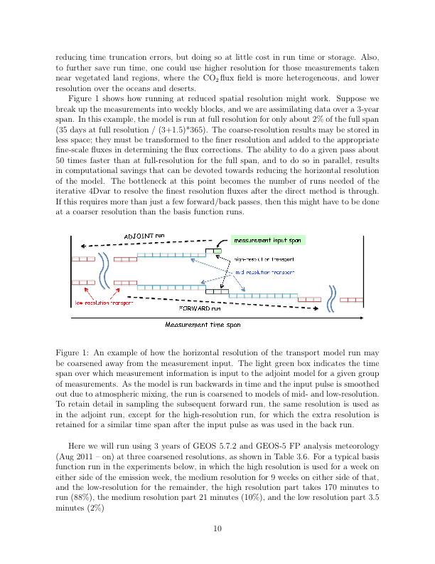
Ways to implement and speed up the method
Group measurements into blocks:
Needed when using satellite data
Choose number of groups to allow [HP_{o}H^{T}+R] to fit into memory
Run basis functions quickly at reduced resolution after initial (high-res) pulse spreads out due to mixing:
No need to store full 3-D CO₂ fields – store only 2-D flux corrections and 3-D field sampled at measurement locations
For problems with many measurements, use as a pre-conditioner for standard iterative 4Dvar (to “fine-tune” flux details inside the region of each measurement group)
Notes:
Q: how much of the work f

Slide 8
High-resolution flux uncertainties
Both current 4Dvar and EnKF methods give a reduced-rank covariance of ≈O(100). If then the number of columns in C is given by:
The number of ensemble members in the EnKF
2x the number of descent iterations in the 4Dvar’s BFGS minimization
In the representer method, the covariance is full rank, with the rank set by the dimension of the matrix that can be inverted by the computer, ≈ O(10,000) say
Extra detail will help converge the iterative 4Dvar faster
At what spatial scales will this higher-rank covariance provide useful error estimates?

